Slide 1


SPECIAL ECONOMIC ZONES
CONTRIBUTION TO SME INTEGRATION AND LOCAL ECONOMIC DEVELOPMENT
Dr. Sid Boubekeur and Peter Kuria Githinji
SYMPOSIUM
SUCCESSFUL HARMONIZATION OF FRAMEWORKS FOR THE DEVELOPMENT AND OPERATIONALIZATION OF NEXT-GENERATION SPECIAL ECONOMIC ZONES (SEZs) IN AFRICA
Douala, Cameroon, January 21–23, 2025

Slide 2




PROJECT IN THE FRAMEWORK OF FRENCH-AFRICAN UNION TECHNICAL FACILITY
STAKEHOLDERS
PARTNERS

Slide 3
1. BACKGROUND, SCOPE AND METHODOLOGY

Slide 4

BACKGROUND
As we step into 2025, it is crucial to reflect on the following questions:
Why, despite decades of support extended to SMEs by governments, Regional Economic Communities (RECs), and international and bilateral institutions, does the situation remain largely unchanged?
Why have efforts to integrate SMEs into value chains and clusters failed to yield significant or scalable results?
One contributing factor, though not the primary one, is that SMEs often operate in highly unfavourable environments and business ecosystem.
This leads us to a critical question: what type of enabling environment or ecosystem would allow SMEs to develop, scale and achieve sustainable growth?
The study “SEZ Contribution to SME Integration and Local Economic Development” identified three key ecosystems that foster SME development and growth:
New Generation Special Economic Zones, both in the maritime and inland (hinterland) areas
Regional planning initiatives for coordinated development
Existing and emerging trade corridors being developed or developing across Africa

Slide 5

SCOPE OF THE POLICY REPORT
THE POLICY DOCUMENT
Draw on successful practices from 10 countries across Africa
Advocate for modern governance and regulatory frameworks to integrate SMEs into SEZs and to boost local economies
Underscores the importance of aligning SEZs investment with ESG principles to attract responsible investment.
Encourage partnerships between SEZs, private sector organizations and financial institutions, to creating sustainable markets and appropriate financial mechanisms
Emphasizes the role of SEZs as hubs for implementing the African Continental Free Trade Agreement (AfCFTA) agenda.
Encourages subcontracting and outsourcing initiatives from large companies operating in SEZs and SMEs
Serves as a guide for governments to reform policies, attract sustainable investments, and support a new generation of SEZs as engines of inclusive and sustainable development.

Slide 6
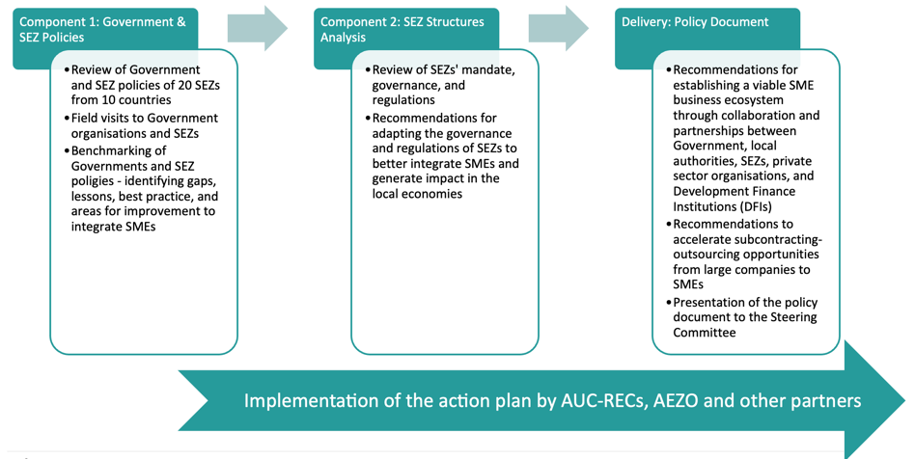
PROCESS THAT INFORMED THE POLICY

Slide 7
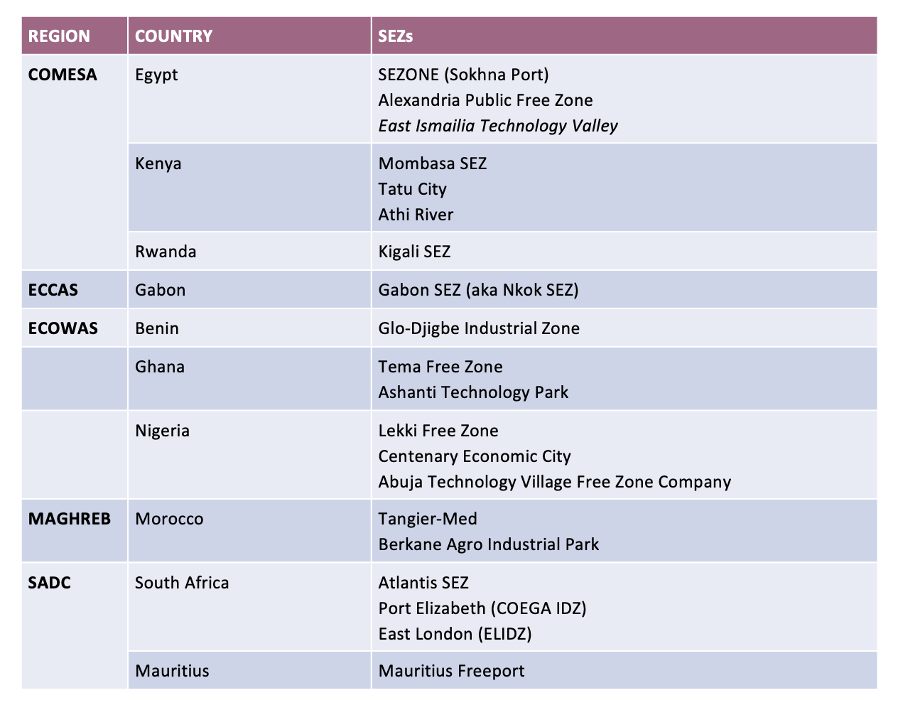
SEZs REVIEW AND BENCHMARKING
In addition to the 20 SEZs, other were reviewed to complement the research:
Egypt: Suez Canal Economic Zone (SCZone), East Ismailia Eco Industrial Park and Robbiki Eco-Leather Park SEZ
Gabon GSEZ Port, Owendo
Madagascar SEZ
Mauritius, Caudan Waterfront SEZ
Kenya: Industrial Technology Park
Ghana: Accra Digital Centre, Enugu Industrial Park and Free-Trade Zone Ghana (Enpower- FTZ),
Nigeria: Dangote Industrial Free Zone and Lagos Free Zone
Morocco: Kenitra Atlantic Free Zone, Nearshore Park SEZ and Midparc Free Zone in Casablanca, Oujda Technopole,
South Africa: Sandalha
TOTAL OF 37 SEZS ANALIZED
Following AUC recommendation, the benchmarking was extended to cover India and China

Slide 8
KEY FINDING AND POLICY RECOMMANDATIONS

Slide 9


Alignment of sectors
Strengthening proper governance
Reduced reliance on fiscal benefits for SEZs
ESG mainstreaming (integration and Compliance)
Increasing the participation of local firms in SEZs activities
Local economic development (SME/ MSMES Ecosystem)
Regional and continental integration (Markets & Leveraging AfCTA, Trade Corridors)
Transitioning to a new generation SEZs
Enhancing and accelerating the exchange of best practices among SEZs in Africa
Action plan

Slide 10
GOVERNMENT AND SEZs PRIORITY SECTORS ARE ALIGNED
ONGOING
Agriculture and agri-business
Manufacturing (textile and apparel, metallurgy, consumer goods…)
Construction, real estate
Infrastructure (transport, logistics)
ICT
Added value to petroleum products
Industrial minerals
Tourism products and services
Education (HEI, TVET)
Financial services…..
Emerging
Biotechnology
Pharmaceuticals
Automotive industry Healthcare
Renewable and green energy
Circular economy (waste management)
AI/ emerging technologies

Slide 11
SEZs POLICIES
Findings
Policy recommendations: strengthening proper governance
Many African governments are upgrading their industrial policies through streamlining, defining and implementing regulatory frameworks that enhance the attractiveness to investors and promoting sustainable development.
Coherent policies and policy frameworks could improve coordination, boost foreign direct investment (FDI), and strengthen linkages between SEZs and national economies.
Streamlined policies could boost the competitiveness of SEZ by focusing on sectors that promote goods and services aligned to regional and continental markets.
Updated policies and regulations can lead to new business practices and models that SEZs from the continent can share. In addition, allowing for partnerships and collaborations between SEZs.
Integrate SEZ regulations into the broader national development strategy ensures alignment with the country’s economic objectives and overarching development agenda.
Promote policies that encourage the use of local content in SEZs, the development of industry clusters and public-private partnerships to generate revenue and employment opportunities.
Enacti legislation granting SEZ authorities’ legal autonomy, establishes them as independent entities with decision-making powers, the capacity to enter contracts, and financial independence.
Ensure transparent and accountable governance structures within SEZ authorities by appointing board members with relevant expertise, including representatives from key ministries, private sector stakeholders, lawyers, researchers, and specialists in urbanization and regional development.
Establish regulations that clearly define the roles and responsibilities of all stakeholders involved in SEZs to enhance efficiency and accountability.
Evaluate the opportunity of merging SEZ authorities with other agencies including Investment Promotion Agencies to streamline investment efficiency,, reduce duplication, minimize operational costs and governance
Include explicit provisions in SEZ regulations mandating compliance with both international and national labour standards, covering aspects such as minimum wages, working hours, occupational health and safety, and the prohibition of child and forced labour.

Slide 12
FISCAL BENEFITS AND DEPENDENCE
Policy recommandation: reduced tax benefits for SEZs
FIndings
Shift from tax-driven incentives toward balanced policies that maximize public revenue while ensuring SEZ competitiveness and sustainability.
Mauritius reduced corporate tax exemptions on exports to enhance domestic revenue and fairness, addressing the economic distortions caused by excessive tax incentives.
Gabon’s Nkok SEZ revised tax exemptions, limiting them to five years for new companies to increase state revenue for public investments, while preserving longer exemptions for existing companies.
Egypt's recent tax policies focus on limiting exemptions, especially within Free Zones, and collaborating with the OECD to improve tax transparency and counter tax minimization by multinational enterprises.
Rwanda’s Kigali SEZ stands out for attracting investment without tax incentives, instead providing a robust regulatory framework, quality infrastructure, and streamlined trade processes.
Reliance from SEZs on tax benefits – unfair competition from countries for attracting SEZs investors.
There is a risk for a race to the bottom.

Slide 13
ESG PERFORMANCE
Policy recommendations: ESG mainstreaming
Findings
Madagascar’s SEZ law (Law No. 2017/023) mandates that SEZ developers and companies prioritize responsible governance, balance social and economic performance, promote workplace diversity, support local communities, implement environmental policies, combat climate change.
Historically, SEZs attracted foreign investment by lowering environmental and social standards, but a recent shift in African SEZs shows that adopting high ESG standards can make zones more attractive to investors, especially those sensitive to reputational risks
Implementing circular economy principles, such as waste recycling and eco-friendly policies, opens new business opportunities.
Successful cases, like Gabon's Nkok SEZ achieving carbon neutrality and Egypt’s and South Africa's eco-focused SEZs, illustrate the benefits of ESG integration. Morocco is also advancing ESG in SEZs, emphasizing renewable energy and energy efficiency.
Promote collaboration and engagement among SEZ authorities, companies, local communities, and relevant stakeholders to work collectively towards achieving ESG goals. This can include regular consultations, dialogues, and partnerships to address ESG challenges and identify sustainable solutions.
Incorporate ESG standards into SEZ regulations, requiring all zone operators and companies to adhere to ESG practices. These standards should cover energy efficiency, waste management, labour rights, human rights, and health and safety.
Implement transparency measures mandating SEZ operators and companies to report on their environmental impacts, labour practices, and community engagement efforts. (Reporting Guidelines).
Establish education and training initiatives including TVET centers within or near SEZs and industrial zones to serve as hubs for cultivating a skilled workforce aligned with industry needs as part of social responsibility.
Reference countries on ESG implementation: Kenya, Mauritius, Morocco, South Africa, Gabon

Slide 14
INCREASING THE PARTICIPATION OF LOCAL FIRMS IN SEZ ACTIVITIES
Policy recommendations: infrastructrure sharing and business clustering
SEZs to facilitate access to infrastructure (energy, transport, water) and simplified regulations to SMEs.
Interaction between large enterprises and SMEs within SEZs through sub-contracting and outsourcing activities facilitating innovation, technology transfer, and market access.
Establish comprehensive support ecosystems tailored to SMEs operating within SEZs such as training, technical assistance, and guidance on financing sources. This should include business incubation programs, mentoring initiatives, and networking opportunities.
In Mauritius, SMEDA collaborates with SEZs to integrate local businesses into supply chains by offering business support, training, and financial access. Other references cases are Egypt, Kenya, Rwanda
Findings
Lack of business-friendly environment for SMEs
Lack of interaction between large enterprises and SMEs within SEZs

Slide 15
LOCAL ECONOMIC DEVELOPMENT
Findings
Policy recommendations: spatial economic planning and development
Local firms have limited capacity to provide cost-effective, quality inputs which disqualifies them from building business collaboration with SEZ firms.
Lack of local supply chain linkages with SEZs and limited competitiveness
Lack of technology and know-how transfer between SEZs and local economic development (spatial economic development)
Promote and facilitate partnerships between SEZs, SMEs, and relevant government agencies or organizations to foster spatial economic development.
Companies operating in SEZs to prioritize local purchasing, hiring, and procurement.
Skilled worker movement between SEZs and the local economy facilitates technology and knowledge transfer.
Morocco and SA exemplifies effective SEZ-SME linkages, prioritizing local economic growth through policies supporting entrepreneurship and local manufacturing.
Improving the product and service quality of SMEs, the quality assurance, standardization, and certification are a key criteria to operating within SEZ frameworks. This enables SMEs to strengthen their quality infrastructure, ensuring compliance with and conformity to export market standards.
Encourage the inclusion of marginalized groups in SEZs' economic development initiatives, ensuring equitable opportunities and participation in economic activities.

Slide 16
REGIONAL AND CONTINENTAL INTEGRATION
Findings
Policy recommendations: leverage of AfCFTA and corridors
This approach aligns with the goals of the African Continental Free Trade Area (AfCFTA), which seeks to foster intra-African trade and integration..
Countries should accelerate reforms for doing business allowing SEZs to play a major role in the development of regional value chains. reputational risks.
Mauritius’ SEZ collaborations with Côte d'Ivoire, Ghana, Madagascar, and Senegal, fosters regional integration and supports local businesses by establishing business corridors and sharing expertise.
Promoting regional development ecosystems and forming strategic partnerships with foreign entities allows countries to expand SEZ market opportunities.
Integration with AFCFTA
Align SEZ policies with AfCFTA objectives for enhanced regional trade
Facilitate trade
Streamline processes to facilitate cross-border trade within the AfCFTA framework.
Preferential treatment
Advocate for preferential treatment of SEZ-produced goods to boost competitiveness.
Market access
Enhance market access for SEZ products through AfCFTA agreements
Corridors as arteries of trade
To align SEZ locations and infrastructure developments with key trade corridors, especially those that support the AfCFTA’s objectives, will facilitate easier access to regional and continental markets, making SEZs more attractive to investment.

Slide 17
TRANSITIONING TO A NEW GENERATION SEZs
Policy recommendation: boosting new generation of SEZ
Findings
SEZs to adopt new busisness models, taking in consideration spatial economic devlopment, including rural areas, SMEs integration and ESG.
To focus on a holistic approach that combines infrastructure development, local resources use , skills development , youth and women and youth employment.
To maximize SEZ benefits, countries must establish policies that encourage local firms’ participation, create supply chain linkages, and support knowledge transfer.
Facilitate the sharing and dissemination of best practices from new-generation SEZs to first-generation zones.
SEZs in the development stage should leverage successful models implemented in countries such as Egypt, Kenya, Morocco, Mauritius, Rwanda, and South Africa.
The first generation of SEZs were located in traditional corridors of business (port, industrial parks of the cities and were primarely foreign owned.
The participation of local firm was limited due to investment requirements

Slide 18
Supporting Local Economic Development/SME Ecosystem Development
Community Engagement
-Local partnerships and networks
-Community-driven projects
Capacity Building
-Training programs for entrepreneurs
-Mentorship initiatives
Innovation and R&D
-Support for local innovations
-Collaborations with research institutions
Tax Benefits and Dependence
Tax Incentives for SMEs
-Reduced tax rates
-Tax holidays Exemptions on certain goods
Tax Compliance Challenges
- Improved Systems
Dependence on Tax Relief
- Sustainability of tax benefits
-Impact on government revenue
Embracing ESG (Integration and Compliance)
Environmental Stewardship
-Sustainable resource management
-Waste reduction initiatives
Social Responsibility
-Community development contributions
Fair labor practices
Governance Standards
-Transparency and accountability
-Ethical business practices
SUMMARY VIEW: DEVELOPMENT AND OPERATIONALIZATION OF NEXT-GENERATION SPECIAL ECONOMIC ZONES
Building a Conducive Environment for SMEs/MSMEs
Regulatory Framework
-Simplification of business registration
-Access to legal support
Access to Finance
-Microloans and grants
-Collaborations with financial institutions
Infrastructure Development
-Reliable supply chains
-Technological advancements
Opportunities in the Regional and Continental Markets
Market Expansion Strategies
-Identifying market gaps
- Building strategic partnerships
Regional Cooperation
-Trade agreements and alliances
-Joint ventures and collaborations
Cultural and Economic Insights
-Understanding local cultures
-Adapting business models
Leveraging on AfCFTA and Trade Corridors
Trade Facilitation
-Streamlined customs processes
-Reduced tariffs and non-tariff barriers
Market Access
-Expanding reach to African markets
-Networking with regional businesses
Infrastructure Investment
- Development of transport corridors
-Enhancing logistics capabilities
Transitioning from First Generation SEZs to New Generation
SEZs Upgrading Infrastructure
-Modern facilities and utilities
-Improved transportation l(logistics) inks
Policy Enhancements
-Flexible regulatory frameworks
-Incentives for high-tech investments
Focus on Sustainability
-Environmental considerations
-Community impact assessments

Slide 19
3. ENHANCING AND ACCELERATING THE EXCHANGE OF BEST PRACTICES AMONGST SEZs IN AFRICA

Slide 20
Successful models on SME / MSME support and growth

Slide 21
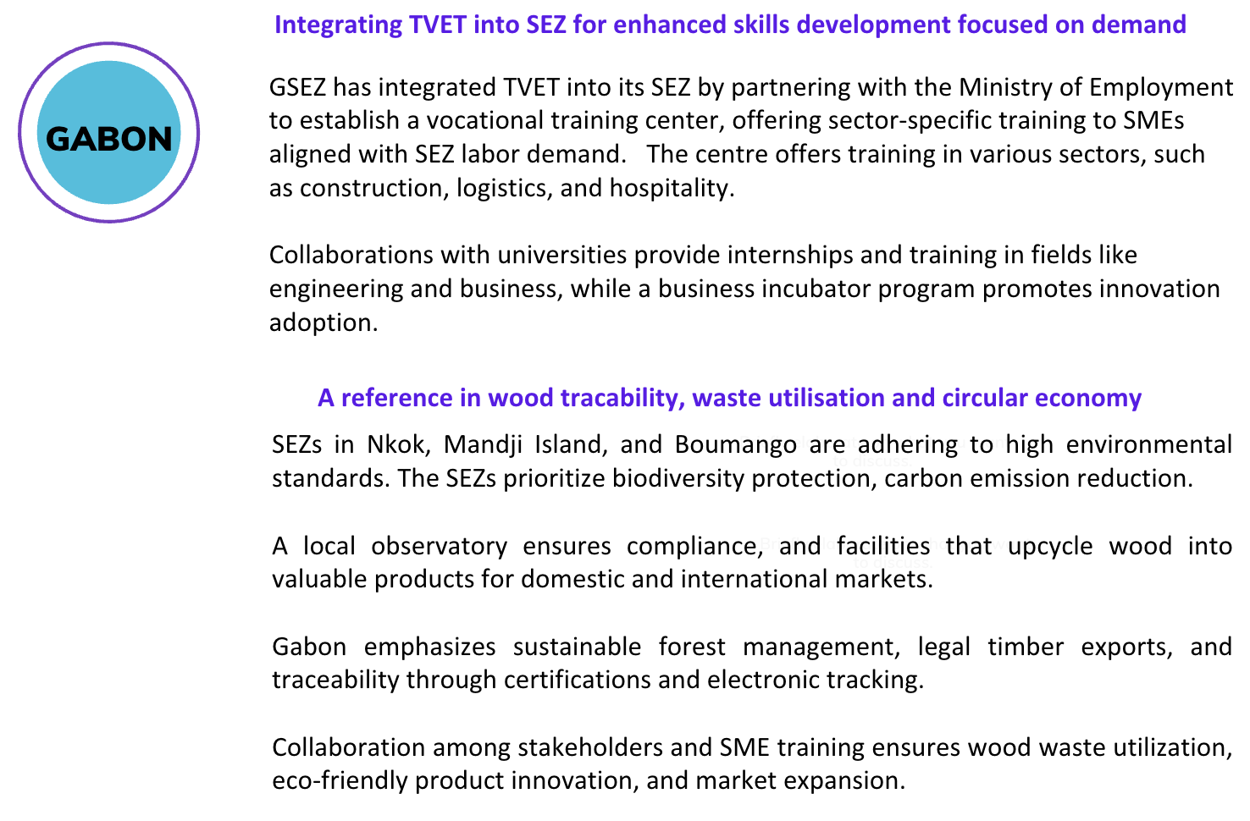

Slide 22
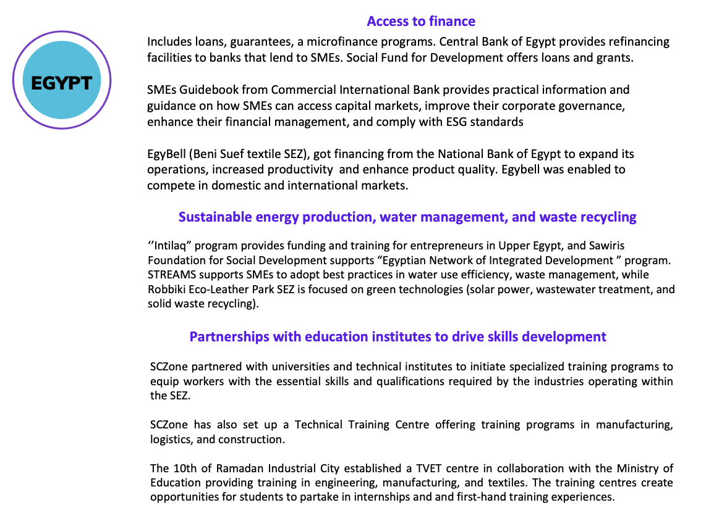

Slide 23
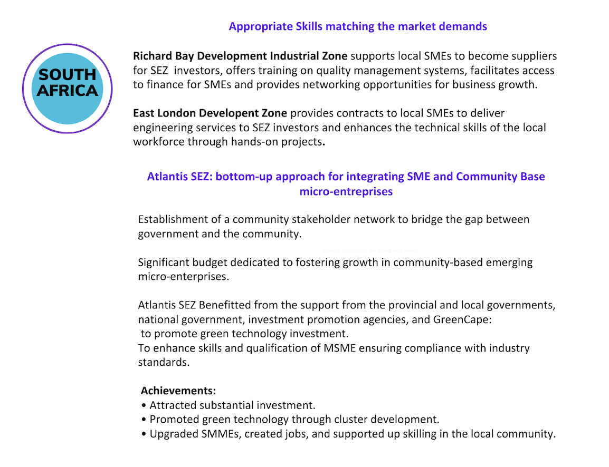

Slide 24
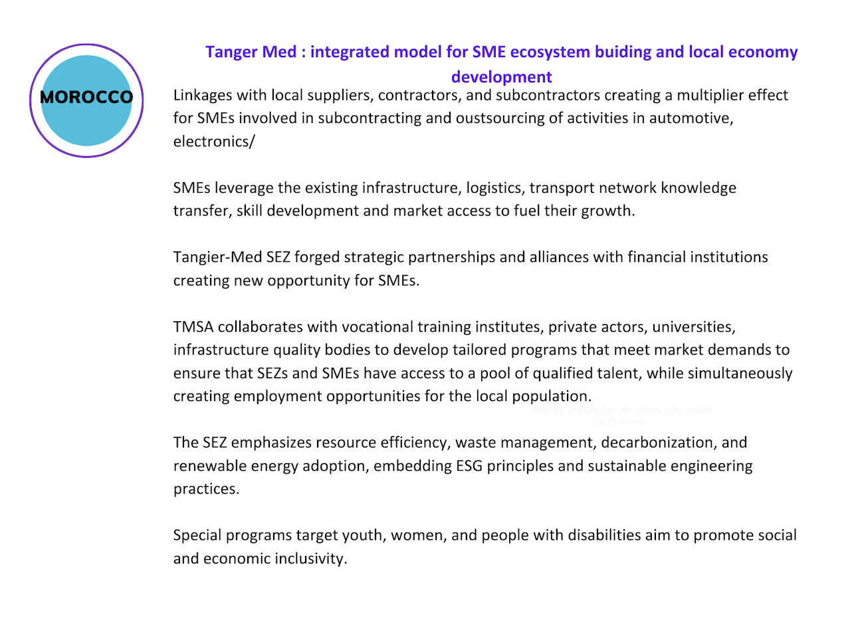

Slide 25
Successful models on regional spatial economic planning and development

Slide 26
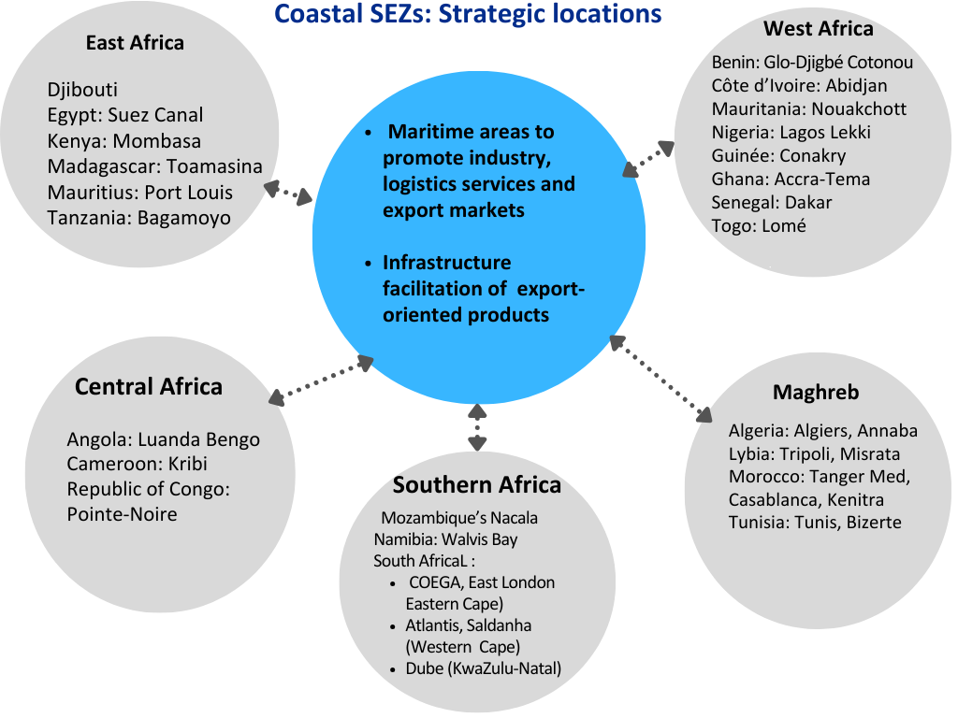

Slide 27
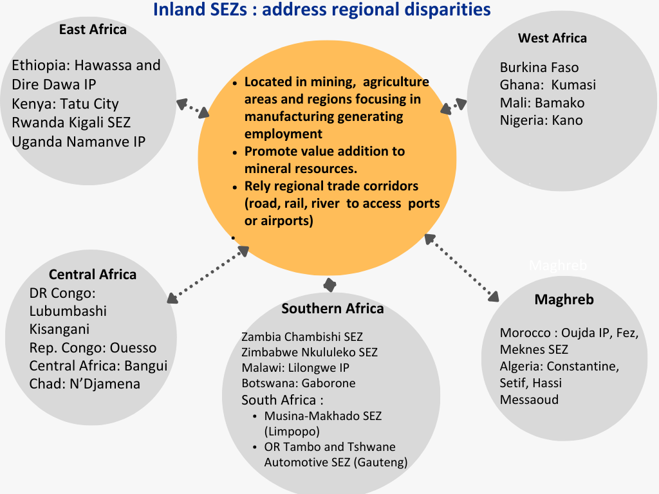

Slide 28
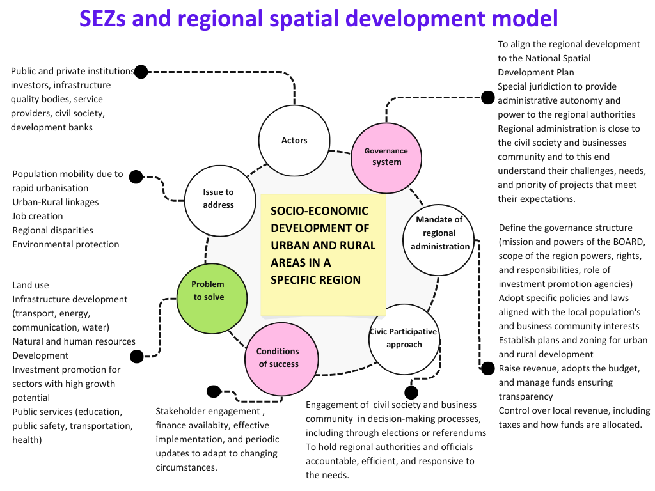

Slide 29
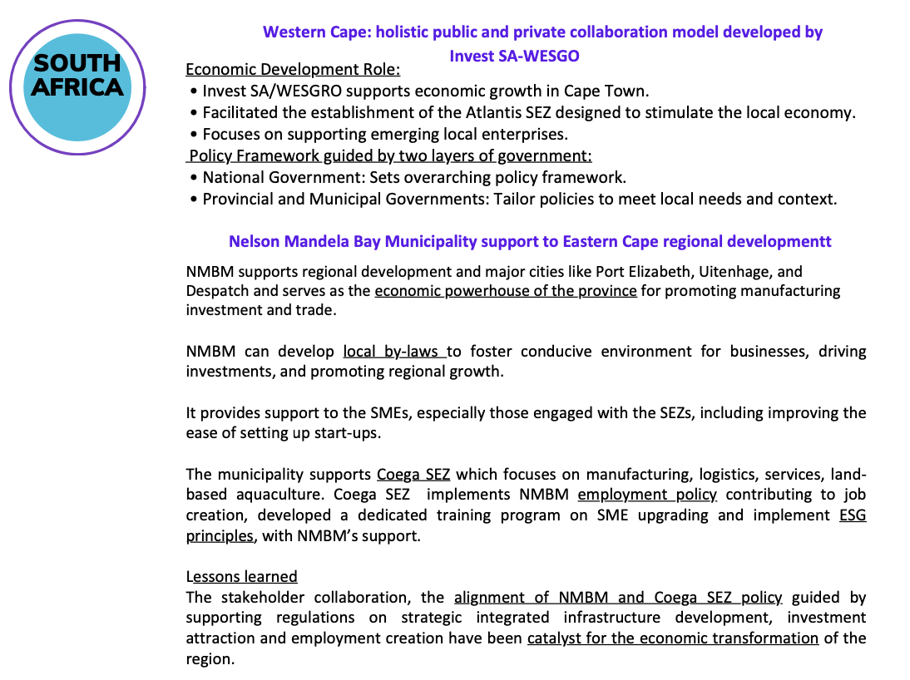

Slide 30
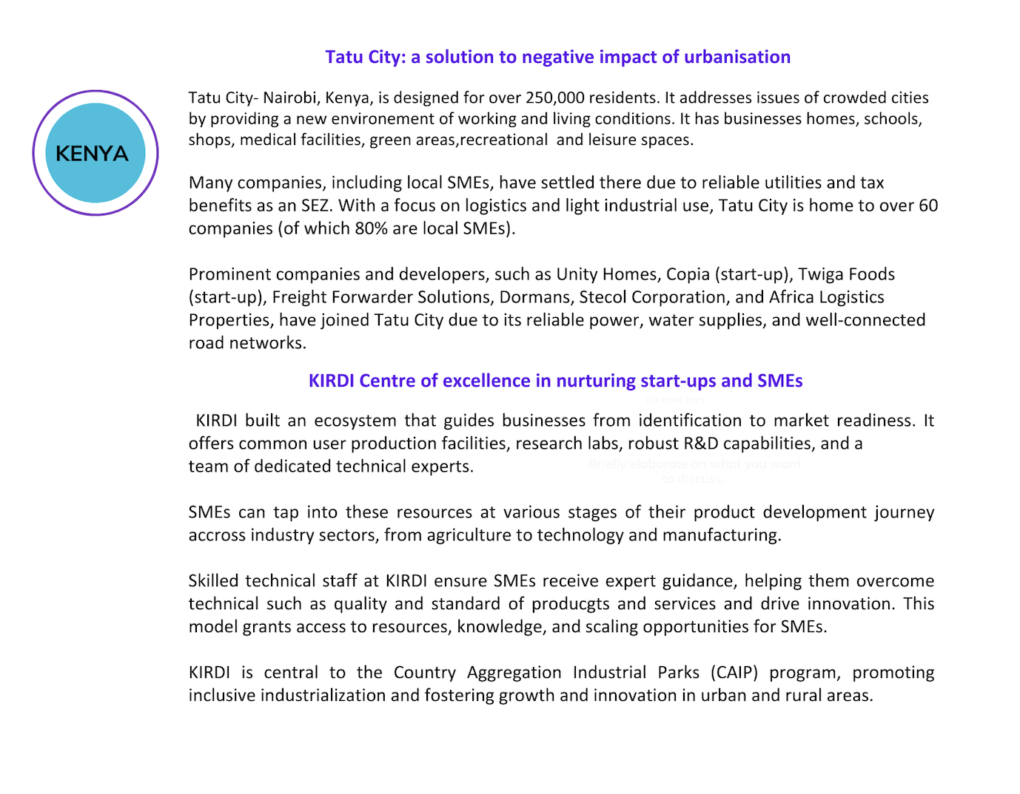

Slide 31
KEY RECOMMENDATIONS
To identify and disseminate successful models implemented in Africa on regional spatial planning and development with SEZ as driver of the economy
To encourage transfer of best pratices, knowledge and technology between African SEZs which developed innovative models on MSME integration and ESG implementation.

Slide 32

4. ACTION PLAN

Slide 33
PHASE 1 AWARENESS CAMPAIGN AND FUND MOBILISATION
2024-2025
Ongoing:
Financed by AFD and implemented by Expertise France, under the France AU – Technical Facility
Two activities identified as priority:
1. Awareness campaigns encouraging AUC member states to include in their industrial policy the contribution of SEZs on SME integration and local economic development.
2. Establishment of a Task Force assisting in the mobilisation of blended financial resources for implementing the Policy recommendations.
The Task Force will comprise, among others, the following key stakeholders:
AUC-ETTIM Department
AEZO
Development Finance Institutions
Africa-EU Global Gateway
Bilateral development agencies

Slide 34
PHASE 2 IMPLEMENTATION OF THE POLICY RECOMMENDATIONS
(2026-2030)
OBJECTIVE
SUPPORT THE TRANSITION OF SEZS TOWARDS A NEW BUSINESS MODEL WITH A FOCUS ON REGIONAL SPATIAL DEVELOPMENT, SME INTEGRATION AND ESG MAINSTREAMING.
SPECIFIC OBJECTIVES
Upgrading SEZs policies for strengthening proper governance
Boosting regional spatial ecosystem, including SMEs integration in SEZs
Support SEZs on ESG compliance and outreach
Leverage of AfCFTA and trade corridors
TARGET :
15 selected countries from the 5 regions.
600 SMEs to integrate in SEZs
DURATION:
5 years
IMPLEMENTATION:
AUC ETTIM in partnership with AEZO, international and bilateral development agencies

Slide 35


Dr. Sid Boubekeur: Team Leader
Sid.boubekeur3@gmail.cpm
Peter Kuria Githinji: SEZs and SME ecosytem expert
peter.g.kuria@gmail.com
For a copy of the policy document please contact AU-ETTIM Department. Mr. Zakaria Ouari,
OuariZ@africa-union.org

